Slide 1
SQL

Slide 2
Agenda
Introduction and history
Integrity
Types of relationship between tables
DDL
DML
Basic SQL queries
Set operations
Aggregate functions
Nested subqueries
SQL join types
Views
Indexes
Transactions
ACID
Isolation levels
Stored procedures
SQL work in details
SQL summary

Slide 3
Introduction
SQL(Structured Query Language) is a computer language aimed to store, manipulate and retrieve data stored in relational databases.
Is used in RDBMS

Slide 4
Introduction
IBM implemented the language, originally called SEQUEL, as part of the System R project in early 1970s
Creators of the query language - Donald Chamberlin, Ray Boyce, creator of query compiler - Raymond Lorie, creator of cost-based optimizer - Pat Selinger
The first commercial relational DBMS using SEQUEL was released by Relational Software Inc. later becoming Oracle(1979)
SQL was standardized by the American Standards Authority (ANSI) in 1986
Rival of SEQUEL - QUEL and Ingres

Slide 5
Introduction
The SQL language has several parts:
Data-definition language(DDL). Provides commands for defining relation schemas, deleting relations and modifying relation schemas.
Interactive data-manipulation language(DML). It includes also commands to insert tuples into, delete tuples from and modify tuples in database, selection.
View definition. Includes commands for defining views.
Transaction control language(TCL). Includes commands for specifying the beginning and ending of transactions.

Slide 6
Introduction
Embedded SQL and dynamic SQL. Defines how SQL statements can be embedded with general-purpose programming languages.
Authorization, data control language(DCL). Includes commands for specifying access rights to relations and views. Examples: GRANT, DENY, REVOKE
Integrity. Includes commands for specifying integrity constraints that the data stored in the database must satisfy. Updates that violate integrity constraints are disallowed. Examples: PRIMARY KEY, FOREIGN KEY, NOT NULL, UNIQUE, CHECK

Slide 7
Integrity
Primary key - defines a column or combination of columns which uniquely identifies each row in the table
Foreign key - identifies any column referencing the PRIMARY KEY in another table
Not null - ensures that all rows in a column contain a definite value
Unique - ensures that a column or a group of columns in each row have a distinct value
Check - defines a business rule on a column

Slide 8

Types of relationships between tables
One-to-one is a type of relation between tables A and B in which one element of A may only be linked to one element of B, and vice versa

Slide 9

Types of relationships between tables
One-to-many is a type of relations between tables A and B in which an element of A may be linked to many elements of B, but a member of B is linked to only one element of A

Slide 10


Types of relationships between tables
Many-to-many is a type of relationship between tables A and B in which A may contain a parent instance for which there are many children in B and vice versa

Slide 11
DDL(Data Definition Language)
DDL - statements used to define database structure or schema. Some examples:
CREATE - to create objects in the database
ALTER - alters the structure of the database
DROP - deletes objects from the database
RENAME - renames an object

Slide 12
DDL
Create table:
CREATE TABLE branch(id integer, name char(15), city char(30), assets integer,
PRIMARY KEY(id), CHECK(assets >= 0))
Delete table:
DROP TABLE branch
Alter table:
ALTER TABLE branch ADD year integer

Slide 13
DML(Data Manipulation Language)
DML - statements used for managing data within schema objects. Some examples:
SELECT - retrieves data from a database
INSERT - inserts data into a table
UPDATE - updates existing data within a table
DELETE - deletes records from a table

Slide 14
Basic SQL queries
Select clause:
SELECT name from branch - Retain duplicates
SELECT DISTINCT name from branch - Remove duplicates
Where clause:
SELECT number FROM loan WHERE name = ‘Somebank’ AND amount > 1200
Rename operation:
SELECT name, number AS id, amount FROM loan
Tuple variables:
SELECT B.name, B.number, L.amount FROM borrower AS B, loan AS L

Slide 15
Basic SQL queries
String operations:
SELECT name FROM customer WHERE street LIKE ‘%Main%’
Ordering the display of tuples:
SELECT DISTINCT name FROM borrower ORDER BY name
SELECT * FROM loan ORDER BY amount DESC, number ASC

Slide 16



Set operations
Union operation: find all customers having a loan, an account or both
(SELECT name FROM depositor) UNION (SELECT name FROM borrower)
Intersect operation: find all customers who have both a loan and an account
(SELECT DISTINCT name FROM depositor) INTERSECT (SELECT name FROM borrower)
Except operation: find all customers who have an account but no loan
(SELECT DISTINCT name FROM depositor) EXCEPT (SELECT name FROM borrower)

Slide 17
Aggregate functions
AVG, MIN, MAX, SUM, COUNT
Example: “Find the average balance for each customer who lives in Lviv and has at least three accounts”
SELECT name, AVG(balance) FROM depositor WHERE city = ‘Lviv’
GROUP BY name HAVING COUNT(account_number) >= 3

Slide 18
Nested subqueries
Set membership: find those customers who borrowed from the bank and who appear in the list of account holders
SELECT DISTINCT name FROM borrower WHERE name IN (SELECT name FROM depositor)
Set comparison: find the names of all branches that have assets greater than those of at least one branch located in Brooklyn
SELECT name FROM branch WHERE assets > SOME (SELECT assets FROM branch WHERE city = ‘Brooklyn’)
>SOME means greater than at least one member

Slide 19
More complex queries
Derived relations: find the maximum across all branches of the total balance at each branch
SELECT MAX(total_balance) FROM (SELECT name, SUM(balance) FROM account GROUP BY name) AS branch_total(name, total_balance)
“With” clause: find accounts with the maximum balance; if there are many accounts with the same maximum balance, all of them are selected
WITH max_balance(value) AS SELECT MAX(balance) FROM account SELECT number FROM account, max_balance WHERE account.balance = max_balance.value

Slide 20
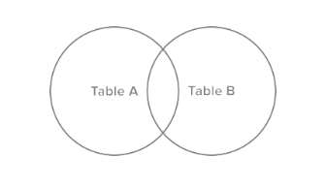
SQL join types
Inner join
Left join
Right join
Full join

Slide 21
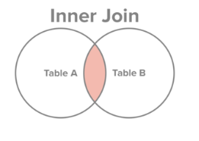
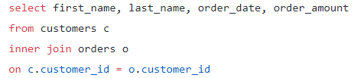
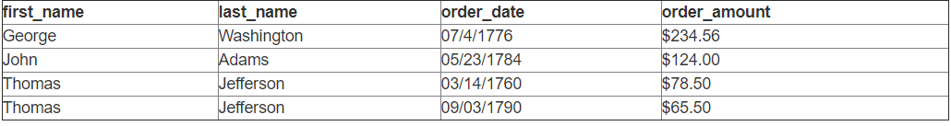
Inner join
Select all records from Table A and Table B, where the join condition is met

Slide 22
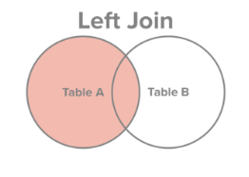
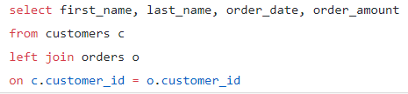
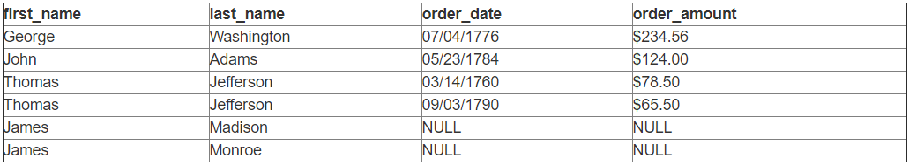
Left join
Select all records from Table A, along with records from Table B for which the join condition is met

Slide 23
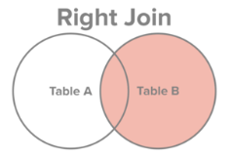
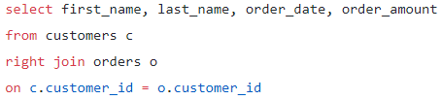
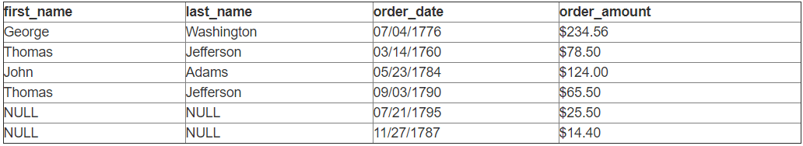
Right join
Select all records from Table B, along with records from Table A for which the join condition is met

Slide 24
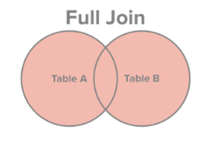
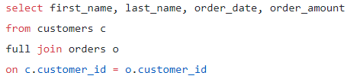
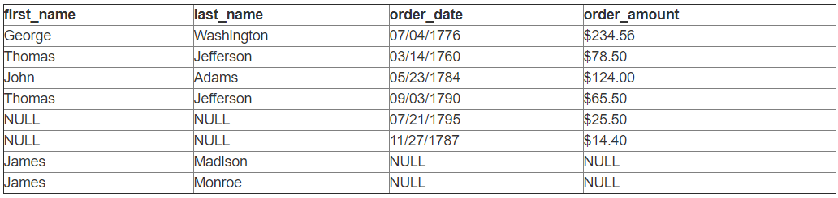
Full join
Select all records from Table A and Table B, regardless of whether the join condition is met or not

Slide 25
Modification of the database
Deletion:
DELETE FROM account WHERE branch_name = ‘SomeName’
Insertion:
INSERT INTO account(number, branch_name, balance) VALUES(‘A-97’, ‘SomeName’, 1200)
Update: pay 5 percent interest on accounts whose balance is greater than average
UPDATE account SET balance = balance * 1.05 WHERE balance > SELECT AVG(balance) FROM account

Slide 26
Views
A view is a virtual table based on the result set of an SQL statement
Views always show up-to-date data. The DB engine recreates the data using the view’s SQL statement every time user queries the view
Find for each branch the sum of the amounts of all the loans at the branch
CREATE VIEW branch_total_loan(name, loan) AS SELECT name, SUM(amount) FROM loan GROUP BY name

Slide 27
Indexes
Indexes are special lookup tables that the database engine can use to speed up data retrieval
Heap table consists of data pages, whereas clustered table consists of index pages and data pages

Slide 28
Transactions
A transaction is a sequence of operations performed (using one or more SQL statements) on a database as a single logical unit of work.
The effects of all the SQL statements in a transaction can be either all committed (applied to the database) or all rolled back (undone from the database)
A database transaction must be ACID (atomic, consistent, isolated and durable).

Slide 29
ACID
Atomicity - in a transaction involving two or more discrete pieces of information, either all of the pieces are committed or none are
Consistency - a transaction either creates a new and valid state of data, or, if any failure occurs, returns all data to its state before the transaction was started.
Isolation - a transaction in process and not yet committed must remain isolated from any other transaction.
Durability - committed data is saved by the system such that, even in the event of a failure and system restart, the data is available in its correct state

Slide 30
Transaction commands
COMMIT - causes transaction to complete. Its database modification are now permanent in the database
ROLLBACK - causes transaction to end, but by aborting. Thus makes no effect on the database
Failures like division by 0 or constraint violation can also cause rollback

Slide 31
Isolation levels
Serializable
Repeatable reads
Read committed
Read uncommitted

Slide 32
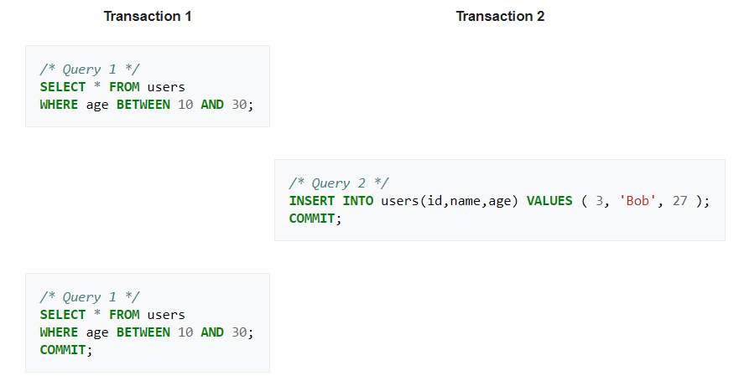
Serializable
Highest isolation level
Requires read and write locks to be released at the end of the transaction
Range-locks are required

Slide 33
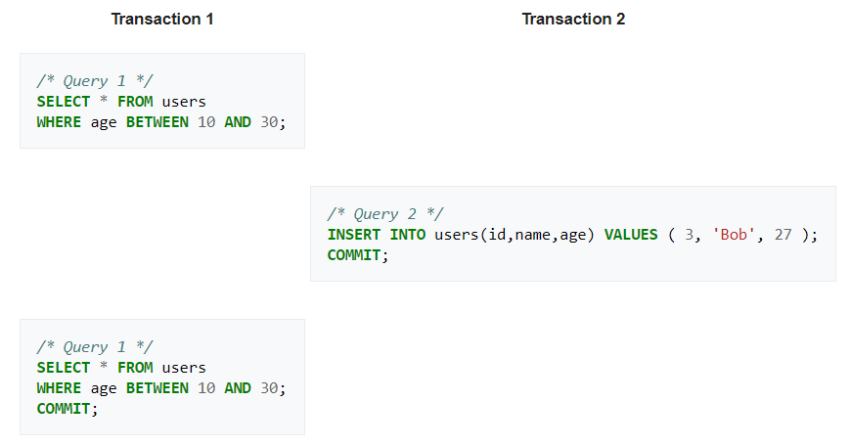
Repeatable reads
Requires read and write locks to be released at the end of the transaction
Range locks are not managed, thus phantom reads can occur
A phantom read occurs when, in the course of a transaction, new rows are added or removed by another transaction to the records being read.

Slide 34
Read committed
Keeps write lock until the end of the transaction.
Read locks are released as soon as the SELECT operation is performed, thus non-repeatable reads phenomenon can occur
Range locks are not managed
A non-repeatable read occurs, when during the course of a transaction, a row is retrieved twice and the values within the row differ between reads.

Slide 35
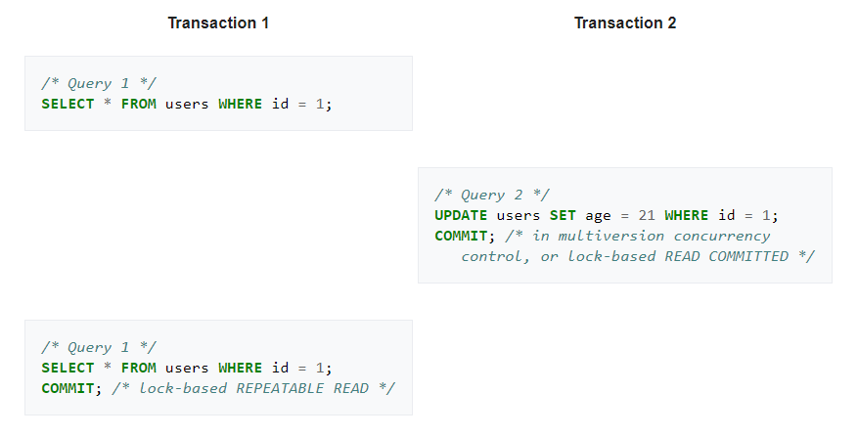
Read committed

Slide 36
Read uncommitted
Lowest isolation level
No locks are required, thus dirty reads can occur
A dirty read (uncommitted dependency) occurs when a transaction is allowed to read data from a row that has been modified by another running transaction and not yet committed

Slide 37
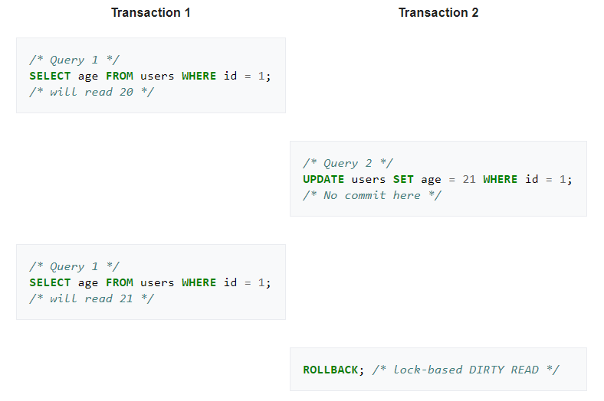
Read uncommitted

Slide 38
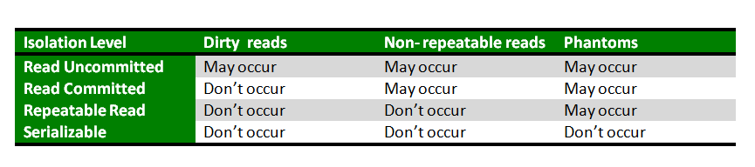
Isolation levels and their drawbacks

Slide 39
Procedural extensions
SQL does not automatize data operations so different DBMS vendors created extensions:
Microsoft SQL Server/Sybase ASE - Transact-SQL
Oracle - PL/SQL
PostgreSQL - PL/pgSQL
MySQL - SQL/PSM
IBM DB2 - SQL PL

Slide 40
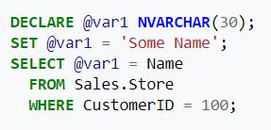
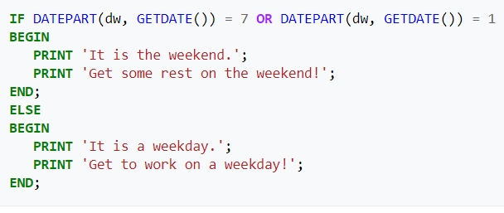
Procedural extensions
Include procedural programming
Possibility to create local variables
Various support functions for string, date, math processings
Flow control

Slide 41
Stored procedures
Stored procedure is a subroutine available to applications that access RDBMS
Stored procedures are stored in the database data dictionary
Have access-control and data-validation mechanisms
Can make changes to DB unlike functions

Slide 42
Pros of stored procedures
Reduce compiling overhead
Less internet traffic
Delegation of access rights
Some protection from SQL injection

Slide 43
Cons of stored procedures
In most cases have vendor-specific language, thus dependency on specific DBMS
Are not as expressed and easy-to-write when it comes to higher level concepts(i.e. Business logic etc.)
Poor tool support for writing and debugging stored procedures

Slide 44
How SQL works
Has relation engine and storage engine
Relation engine parses statements, optimizes them, compiles the code and manages the query execution
Storage engine retrieves and manipulates data stored on disk

Slide 45
Parsing
Check for correct syntax
Perform binding
Check whether tables and columns exist
Loading metadata
Replaces view with its query
Use joins instead of subqueries
Simplifies negative expressions

Slide 46
Compilation
Look for statements which won’t be a part of optimization process and run them through language compiler
These statements are:
Variable declarations and assignments
Conditional processing with IF, ELSE etc.
Iteration with WHILE, FOR

Slide 47
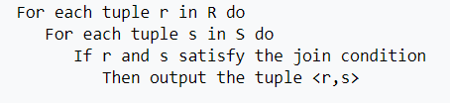
Optimization
Query optimizer determines the ideal execution plan in several phases
1st - looks for trivial plan
2nd phase - looks for a plan which is good enough(e.g. Uses nested-loop joins and one index per table)
3rd phase - investigates more complex plans (e.g. using multiple indexes on a table)
4th phase - looks for more complex possibilities
After the optimizer develops a plan and returns it to the query processor for execution, the plan goes into DBMS cache with already assigned execution cost

Slide 48
Query execution
DBMS checks if plan is in cache using cache key which is generated during optimization process
If plan is in cache - query is executed
If not - query needs recompilation and reoptimization. It can happen when metadata related to query changed(e.g. adding or removing columns or indexes)

Slide 49
Pros of SQL
Independance from a specific DBMS
Is based on defined standards
Declarative

Slide 50
Cons of SQL
Inconsistency when it comes to relational data model
Repetitive rows
Indefinite values(NULL)
Explicit column order from left to right
Unnamed and repetitive names of columns
Considerable excess
Complexity for non-technical people
Deviation from standards when it comes to usage outside SQL Core

Slide 51
Summary about SQL databases
SQL databases are relational
SQL databases are table based with predefined schema
SQL databases are vertically scalable
SQL databases use SQL
SQL databases are good fit for the complex query intensive environment
SQL databases are not best fit for hierarchical data storage
SQL databases are best fit for heavy duty transactional type applications
SQL databases emphasizes on ACID properties
SQL databases have excellent support from their vendors
SQL databases are either open-source(MySQL, PostgreSQL, SQLite etc) or close-sourced from commercial vendors(MS SQL Server etc)

Slide 52
Literature
www.wikipedia.org
www.sqlcourse.com
www.w3schools.com
www.udemy.com

Slide 53
Дякую за увагу!
Виконав Щур Богдан,
студент групи ПМІ-51

